Slide 1

Marketing Campaign Optimization – Travel Assured

Slide 2
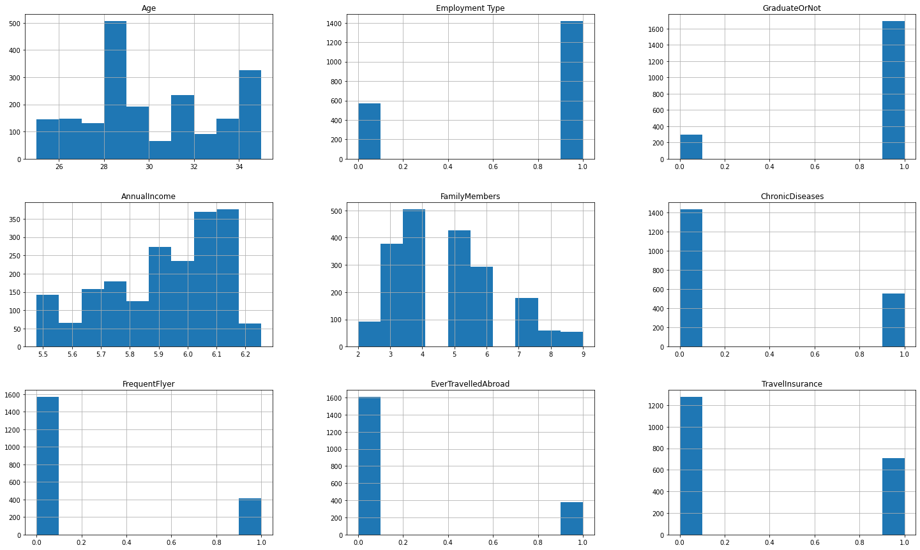
Notes:
Distribution of the Data:
+ Age: Between 25-35, majority are 28-29, and 34-35
+ Employment Type: Majority are employed
+ Graduate: Majority are graduated
+ Annual Income: Majority are wealthy
+ Family Members: Majority with less than 4 children
+ Chronic Disease: Majority are healthy
+ Frequent Flyer: Majority are not frequent flyer
+ Ever Travelled Abroad: Majority have never travelled abroad
+ Travel Insurance: Majority do not buy travel insurance

Slide 3
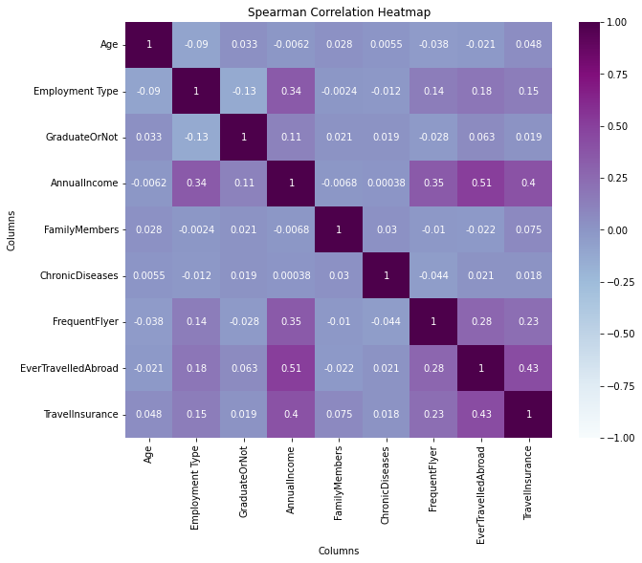
Spearman Correlation Heatmap
Notes:
Strong Correlations Between:
+ Annual Income – Ever Travelled Abroad
+ Annual Income – Frequent Flyer
+ Annual Income – Employment Type
+ ANNUAL INCOME – TRAVEL INSURANCE
Strong Correlation with Travel Insurance:
+ Ever Travelled Abroad – Travel Insurance
+ Annual Income – Travel Insurance
+ Frequent Flyer – Travel Insurance

Slide 4
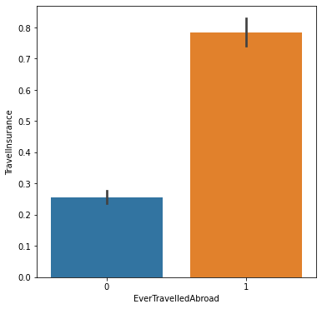
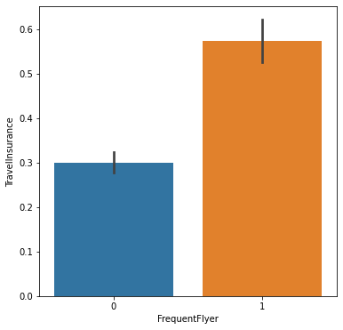
Travellers Buy Insurance
Notes:
+ Employment Type → Employed: 40% buys insurance / Unemployed: 25% buys insurance
+ Graduate → Graduate: 35% buys insurance / Not Graduate: 33% buys insurance
+ Chronic Disease → Yes: 36% buys insurance / No: 35% buys insurance
+ Frequent Flyer: Yes → 55% buys insurance / No: 30% buys insurance
+ Ever Travelled Abroad: Yes → 75% buys insurance / No: 25% buys insurance

Slide 5
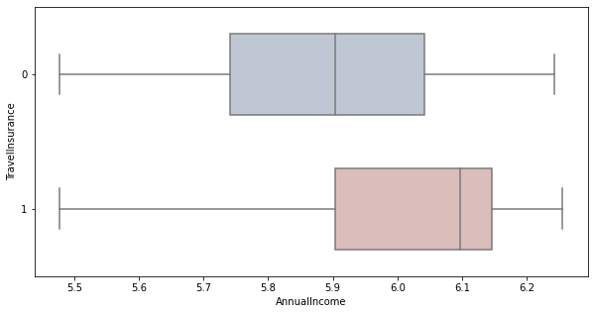
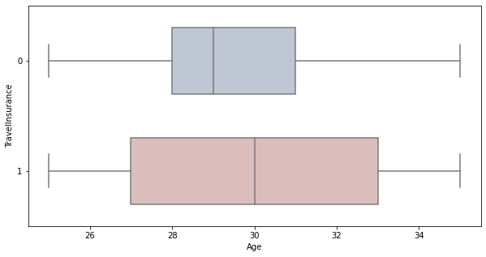
Annual Income & Age
Notes:
Regarding the Correlation Heatmap → Higher Annual Income – More Likely to Buy Insurance → Correlation Coefficient: 0.4
Very Low Corr. Coef.: 0.048 → According to the median on the boxplots → Older people may be more likely to buy insurance

Slide 6
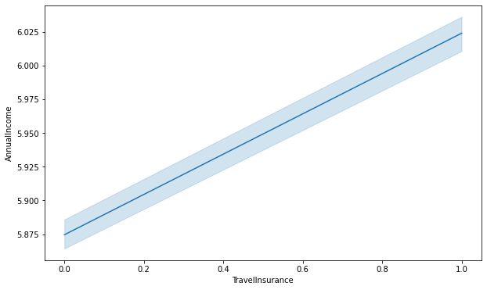
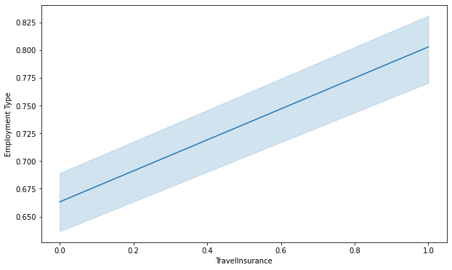
Annual Income & Employment

Slide 7
Summary of Findings
Majority of the people in our database are relatively young, graduated, employed, healthy, not travelling much, and not purchasing insurance
Annual income – which comes from employment – is the strongest drive when considering to travel for the first time
Frequent flyers and those people who have travelled before will most likely purchase an insurance
30+ years old, employed travelers who have a higher income will most likely purchase an insurance

Slide 8
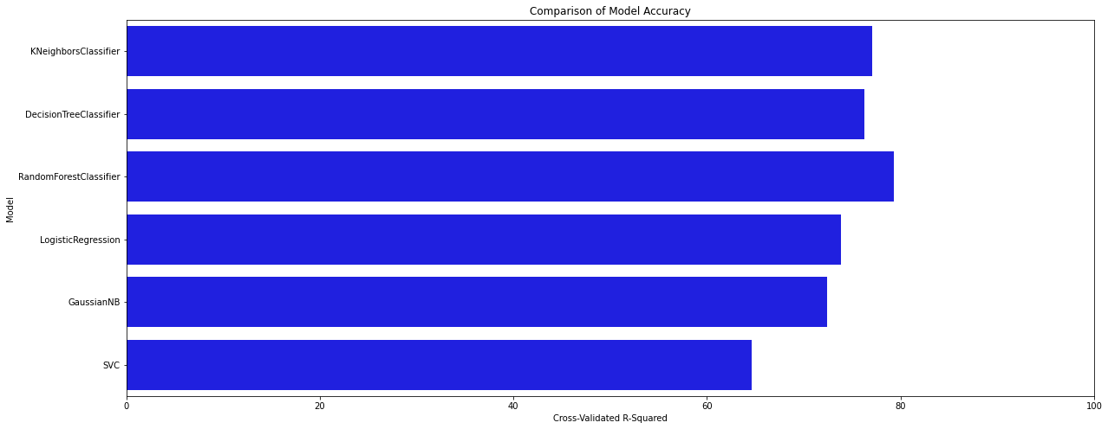
+Bonus: Random Forest is the Winner

